Slide 1
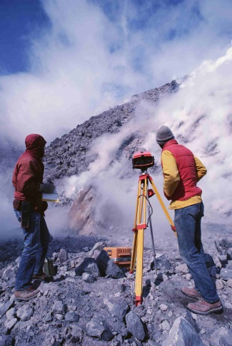
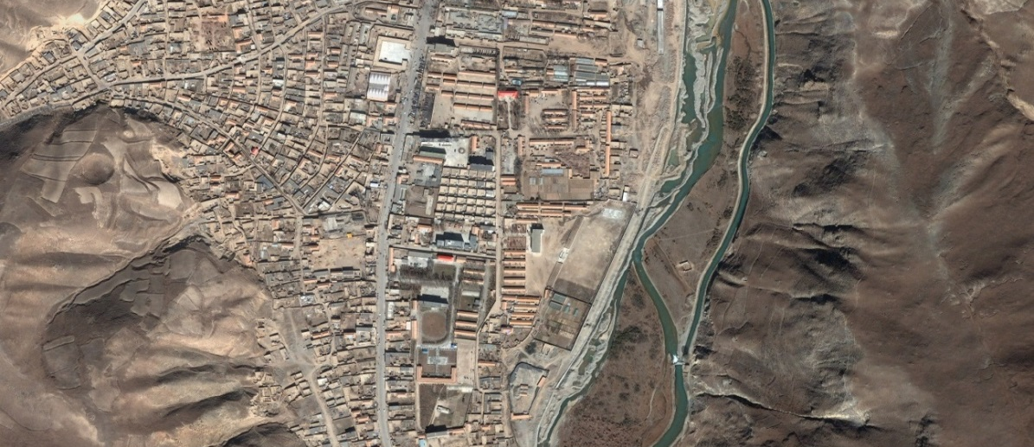
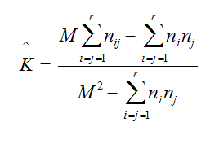
Accuracy Assessment

Slide 2
Accuracy Assessment
Because it is not practical to test every pixel in the classification image, a representative sample of reference points in the image with known class values is used

Slide 3
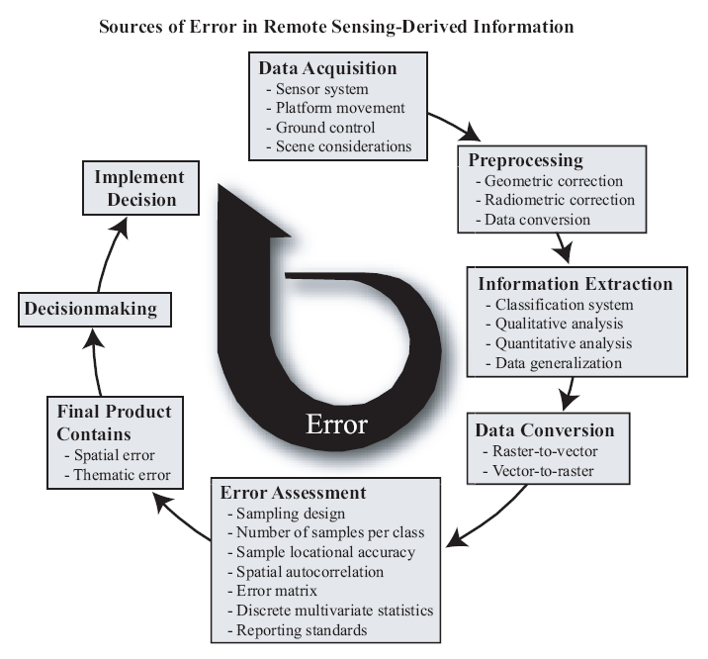
Sources of Errors

Slide 4
Ground Reference Test pixels
Locate ground reference test pixels (or polygons if the classification is based on human visual interpretation) in the study area.
These sites are not used to train the classification algorithm and therefore represent unbiased reference information.
It is possible to collect some ground reference test information prior to the classification, perhaps at the same time as the training data.
Most often collected after the classification using a random sample to collect the appropriate number of unbiased observations per class.

Slide 5
Sample Size
Sample size N to be used to assess the accuracy of a land-use classification map for the binomial probability theory:
P - expected percent accuracy,
q = 100 – p,
E - allowable error,
Z = 2 (from the standard normal deviate of 1.96 for the 95% two-sided confidence level).

Slide 6
Sample Size
For a sample for which the expected accuracy is 85% at an allowable error of 5% (i.e., it is 95% accurate), the number of points necessary for reliable results is:

Slide 7
Sample Size
With expected map accuracies of 85% and an acceptable
error of 10%, the sample size for a map would be 51:

Slide 8
Accuracy assessment “best practices”
30-50 reference points per class is ideal
Reference points should be derived from imagery or data acquired at or near the same time as the classified image
If no other option is available, use the original image to visually evaluate the reference points (effective for generalized classification schemes)

Slide 9
Sample Design
There are basically five common sampling designs used to
collect ground reference test data for assessing the accuracy
of a remote sensing–derived thematic map:
1. random sampling,
2. systematic sampling,
3. stratified random sampling,
4. stratified systematic unaligned sampling, and
5. cluster sampling.

Slide 10
Sample Methods

Slide 11
Commonly Used Methods of Generating Reference Points
Random: no rules are used; created using a completely random process
Stratified random: points are generated proportionate to the distribution of classes in the image
Equalized random: each class has an equal number of random points
Notes:
The latter two are the most widely used; why? (to make sure each class has some points)
With a “stratified random” sample, a minimum number of reference points in each class is usually specified (i.e., 30)
Give an example of each using a 3 class image (80% forest, 10% urban, 10% water) & 30 reference points:
completely random: 30 forest, 0 urban, 1 water
stratified random: 24 forest, 3 urban, 3 water
equalized random: 10 forest, 10 urban, 10 water

Slide 12
Commonly Used Methods of Generating Reference Points
The latter two are the most widely used to make sure each class has some points
With a “stratified random” sample, a minimum number of reference points in each class is usually specified (i.e., 30)
For example, a 3 class image (80% forest, 10% urban, 10% water) & 30 reference points:
completely random: 30 forest, 0 urban, 1 water
stratified random: 24 forest, 3 urban, 3 water
equalized random: 10 forest, 10 urban, 10 water
Notes:
The latter two are the most widely used; why? (to make sure each class has some points)
With a “stratified random” sample, a minimum number of reference points in each class is usually specified (i.e., 30)
Give an example of each using a 3 class image (80% forest, 10% urban, 10% water) & 30 reference points:
completely random: 30 forest, 0 urban, 1 water
stratified random: 24 forest, 3 urban, 3 water
equalized random: 10 forest, 10 urban, 10 water

Slide 13
Primary data capture
Surveying
Uses expensive field equipment and crews
Most accurate method for large scale, small areas
GPS
Collection of satellites used to fix locations on Earth’s surface
Field Spectrometer
High resolution imagery

Slide 14
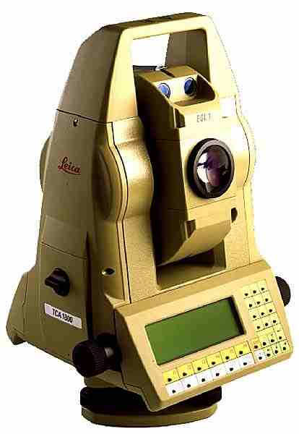
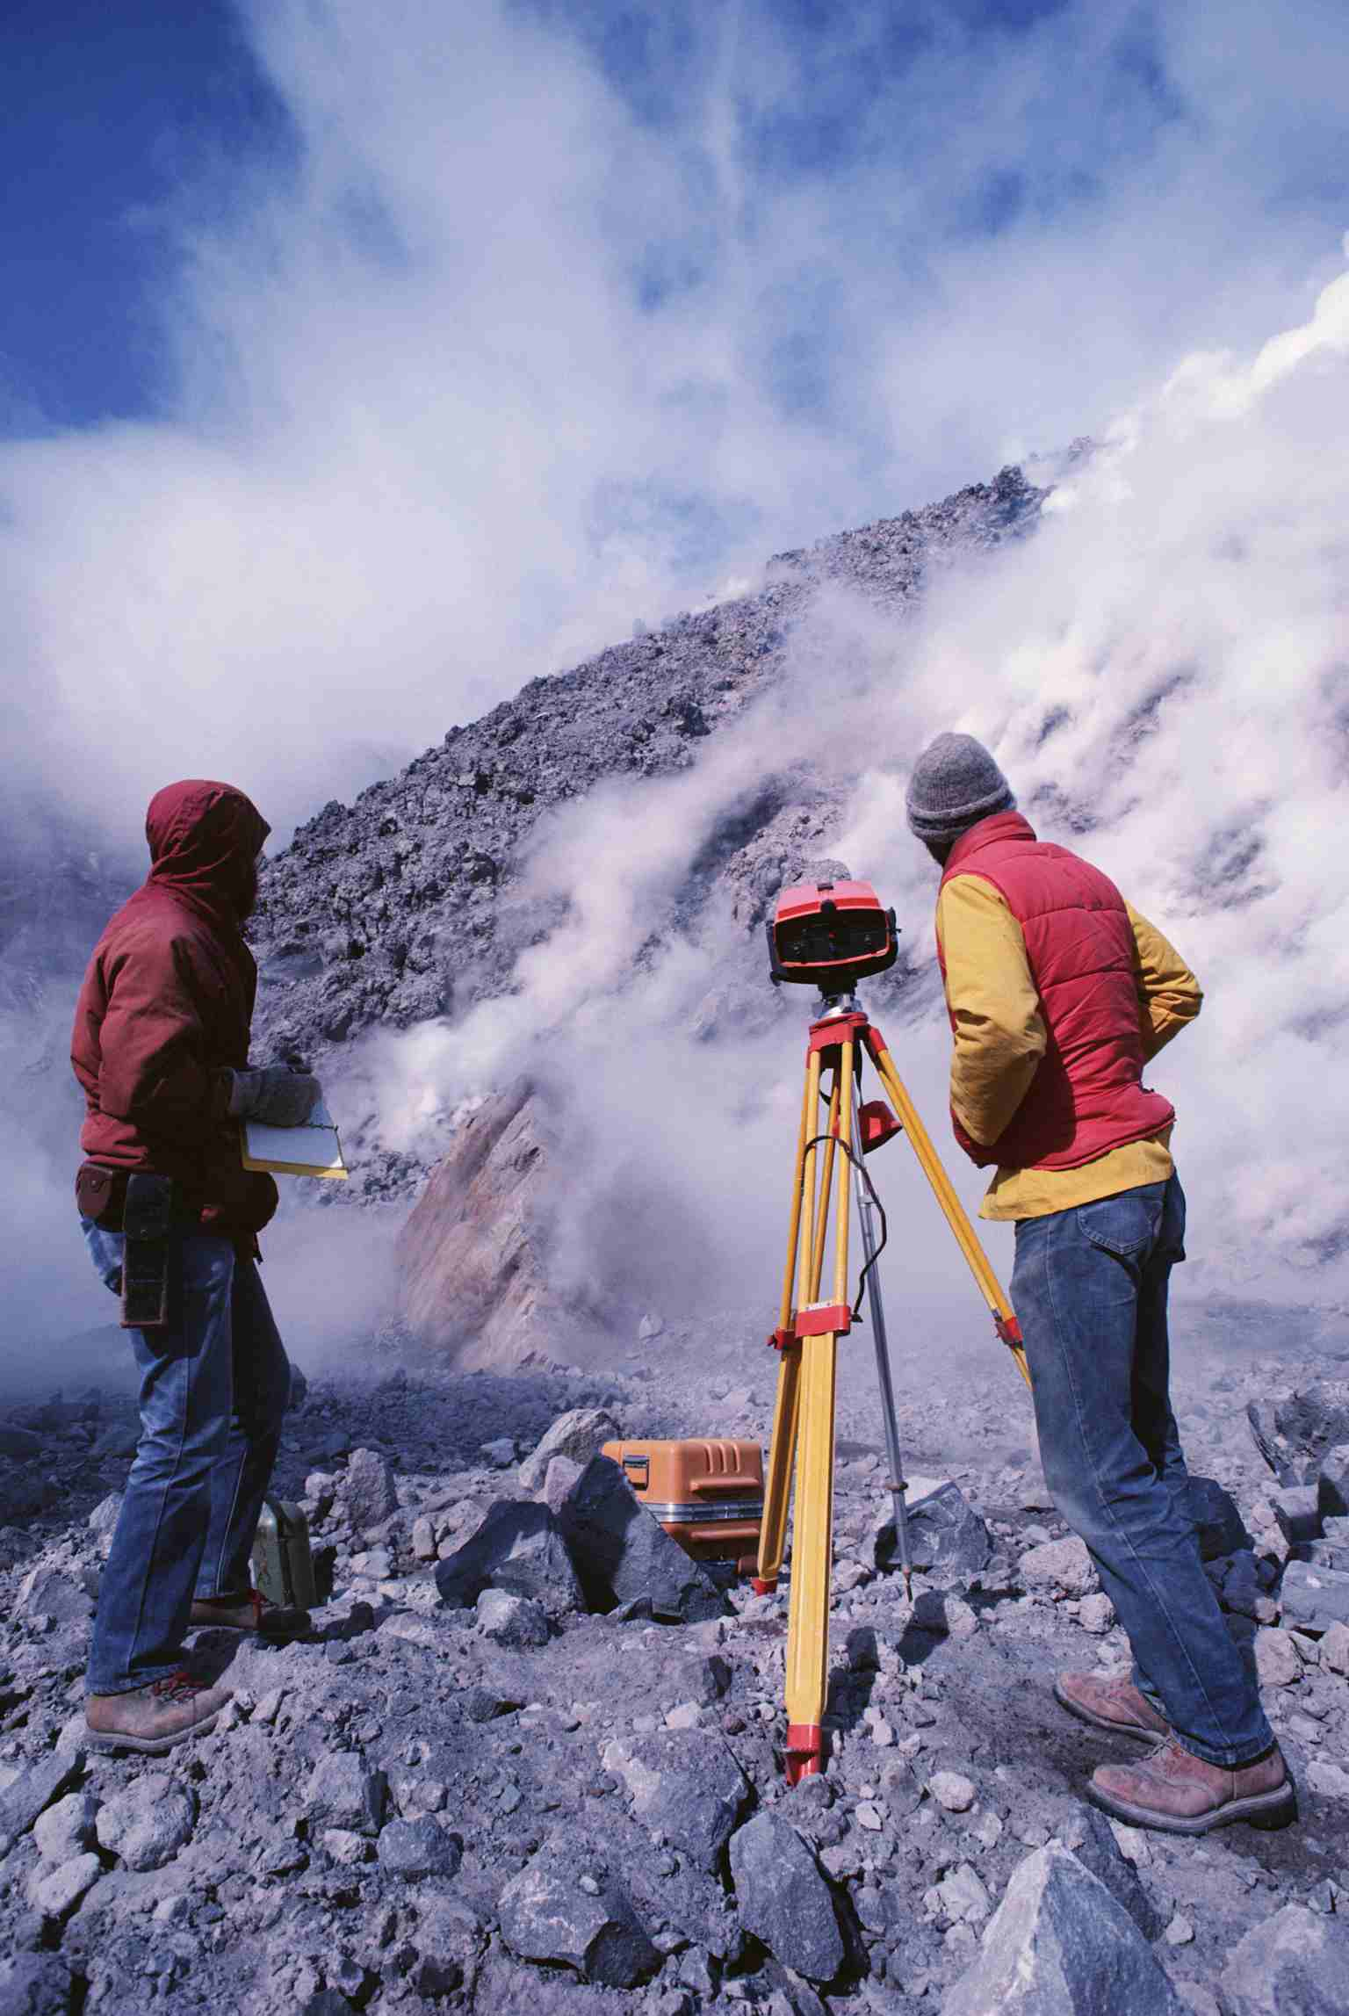
Total Station
Notes:
Can combine surveying with GPS - angles, distances, line-of-sight, measured points

Slide 15






GPS “Handhelds”
geographic coordinates
text
photos
video
audio
Bluetooth, WiFi

Slide 16
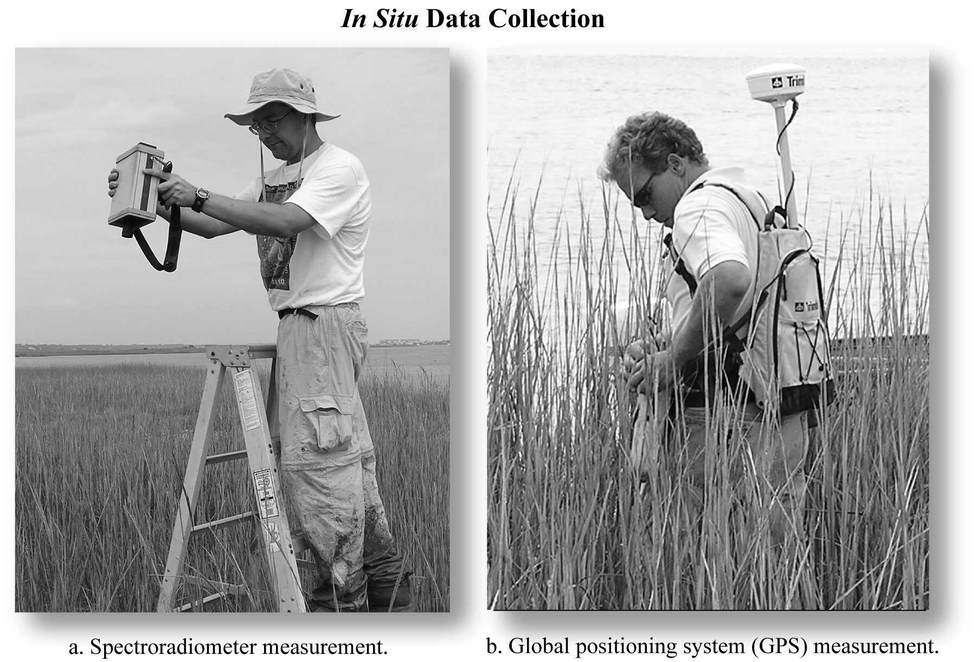
Field Spectrometer

Slide 17
High Resolution Imagery
Sensor | Panchromatic | Multispectral | Bands
QuickBird | 65 cm | 2.62 m | blue, green, red, NIR, panchromatic
WorldView-1 | 50 cm | na | Panchromatic
WorldView-2 | 46 cm * | 1.85 m * | coastal, blue, green, yellow, red, red edge, NIR, NIR2, panchromatic
IKONOS | 82 cm | 3.2 m | blue, green, red, NIR, panchromatic
OrbView-3 | 1 m | 4 m | blue, green, red, NIR, panchromatic
GeoEye-1 | 41 cm * | 1.65 m | blue, green, red, NIR, panchromatic

Slide 18
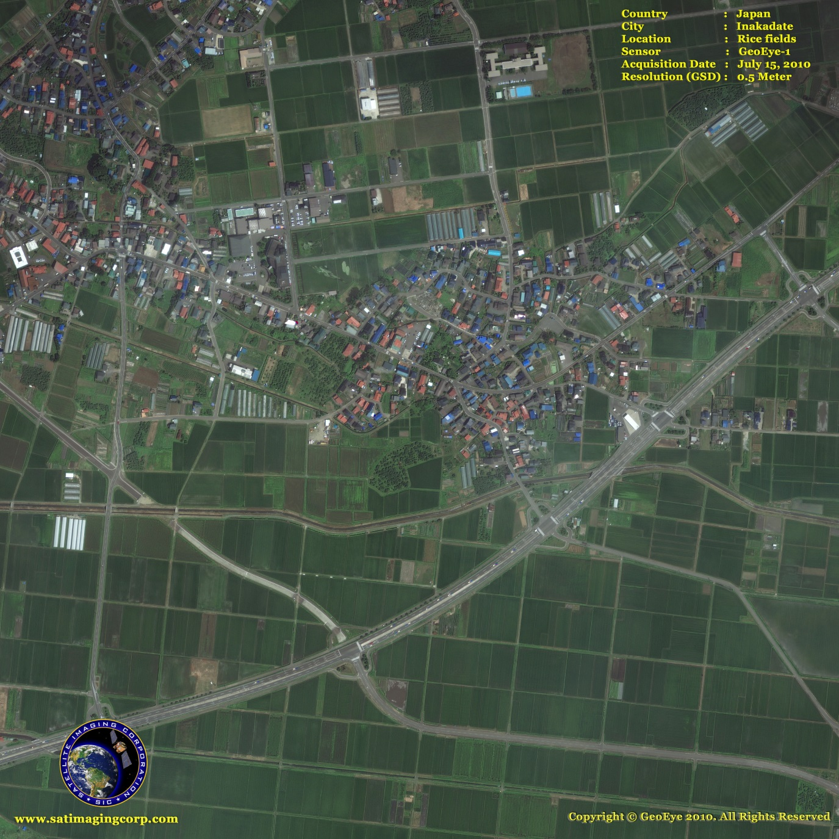
High Resolution Imagery - GeoEye
Notes:
This half-meter GeoEye-1 satellite image of Inakadate, Aomori depicts the village's rice fields. Inakadate's economy depends heavily on agriculture, most notably its rice and horticulture

Slide 19
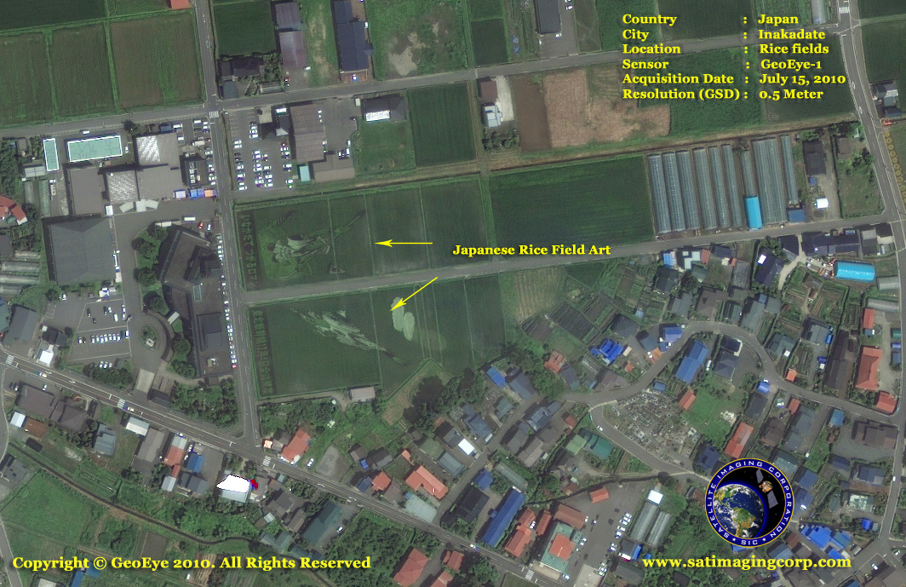
High Resolution Imagery - GeoEye
Notes:
Tanbo art, a collaborative effort in which pictures are created by combining different types of rice, is seen here in this half-meter GeoEye-1 satellite image. The Japanese village of Inakadate first began creating tanbo art as the result of a 1993 revitalization effort.

Slide 20
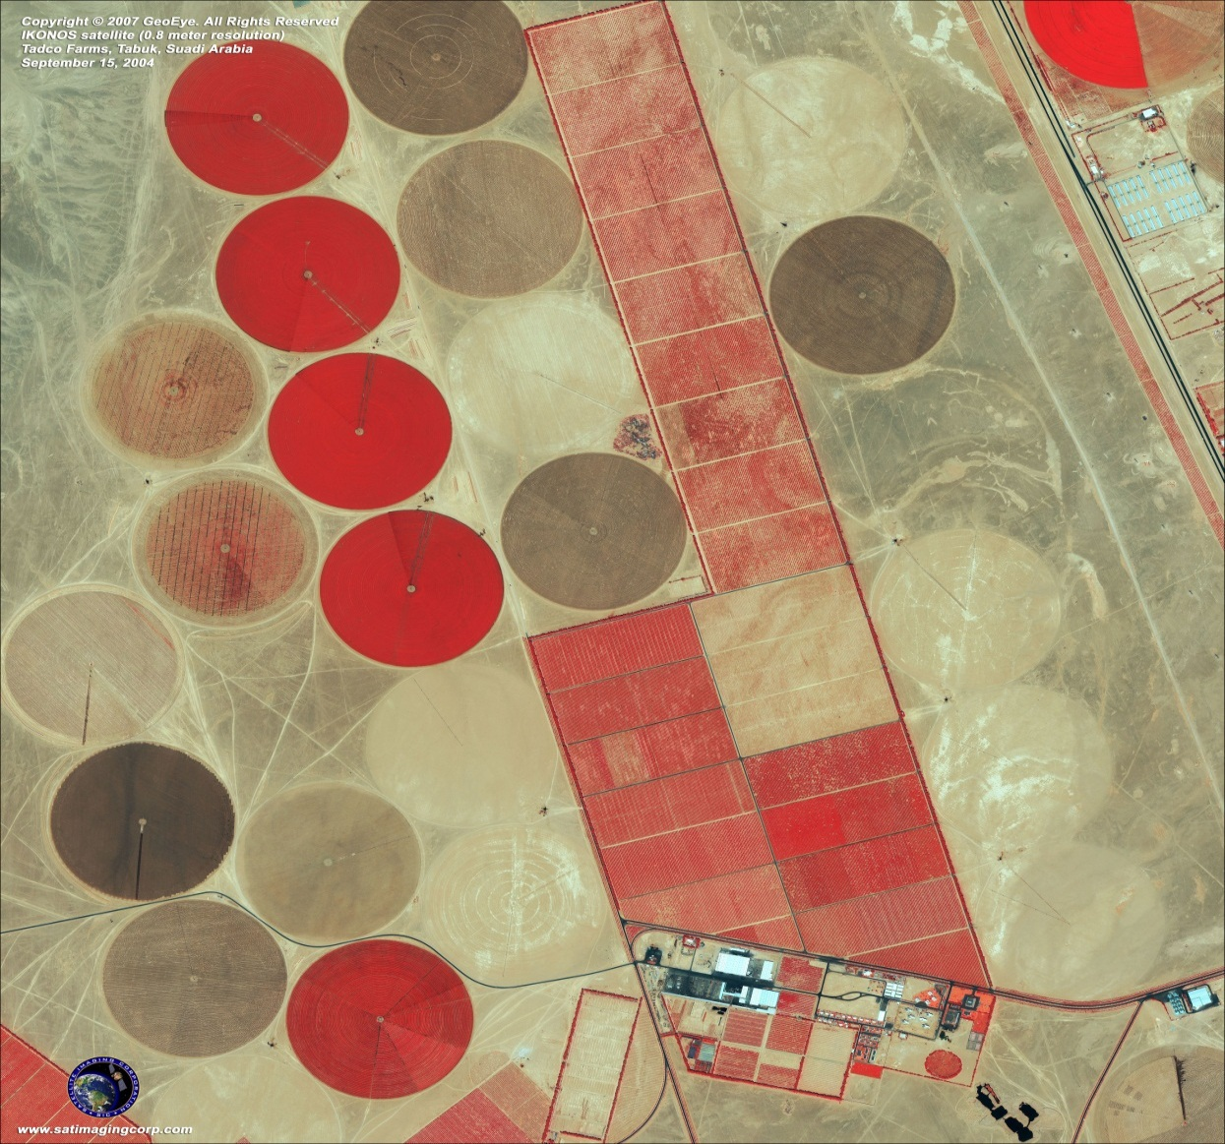
High Resolution Imagery - IKONOS

Slide 21
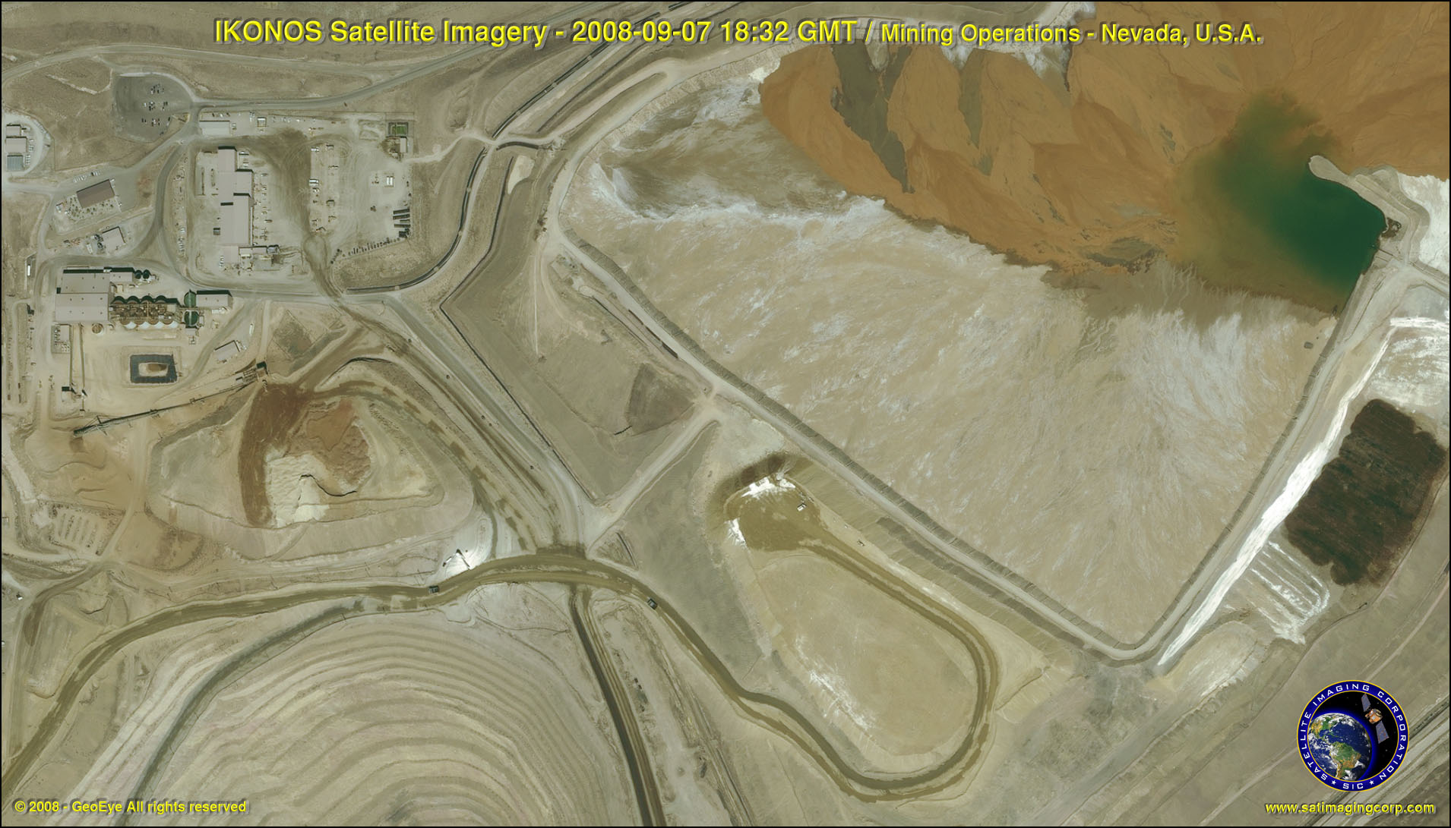
High Resolution Imagery – IKONOS
Notes:
This 1-meter satellite image depicts mining operations in Nevada, United States.

Slide 22
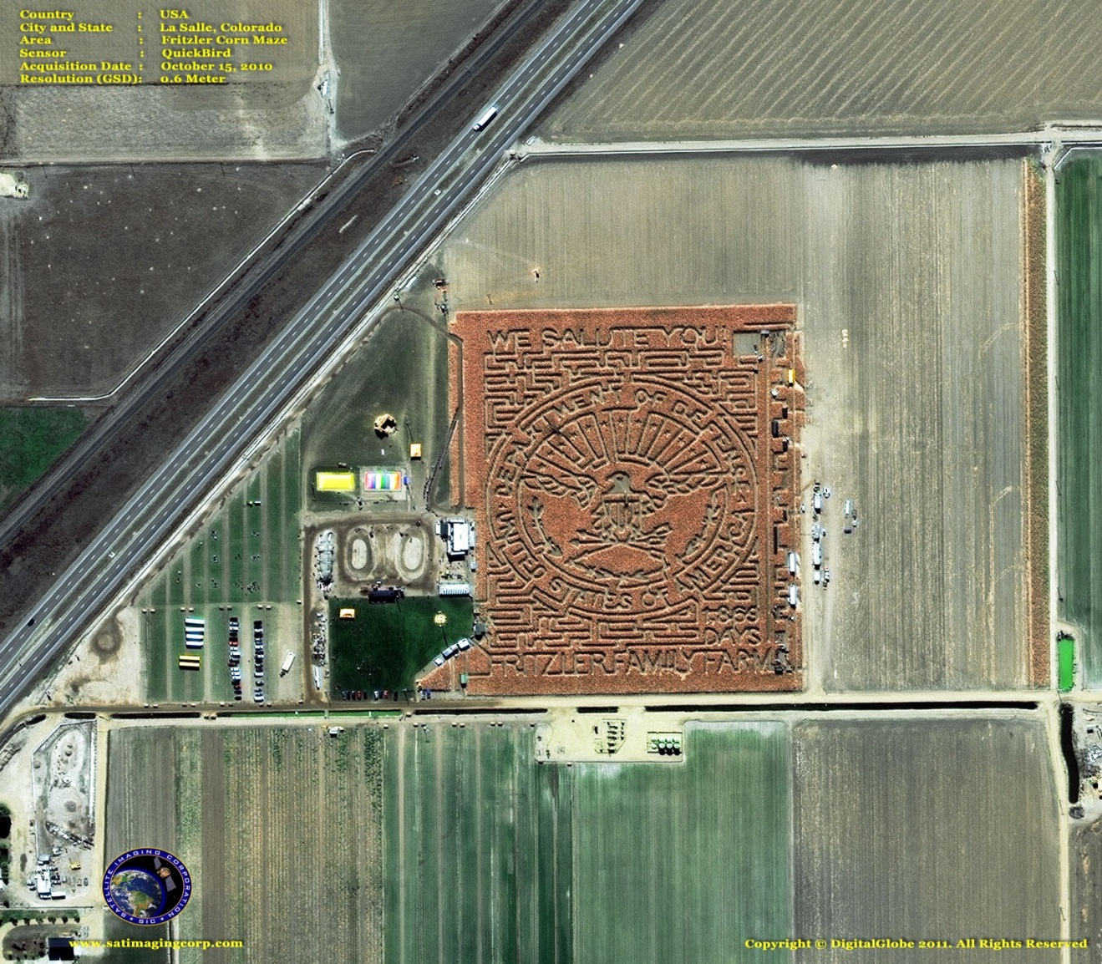
High Resolution Imagery – QuickBird
Notes:
This 0.6m QuickBird satellite image depicts the famous Fritzler Corn "MAiZE" in LaSalle, Colorado.

Slide 23
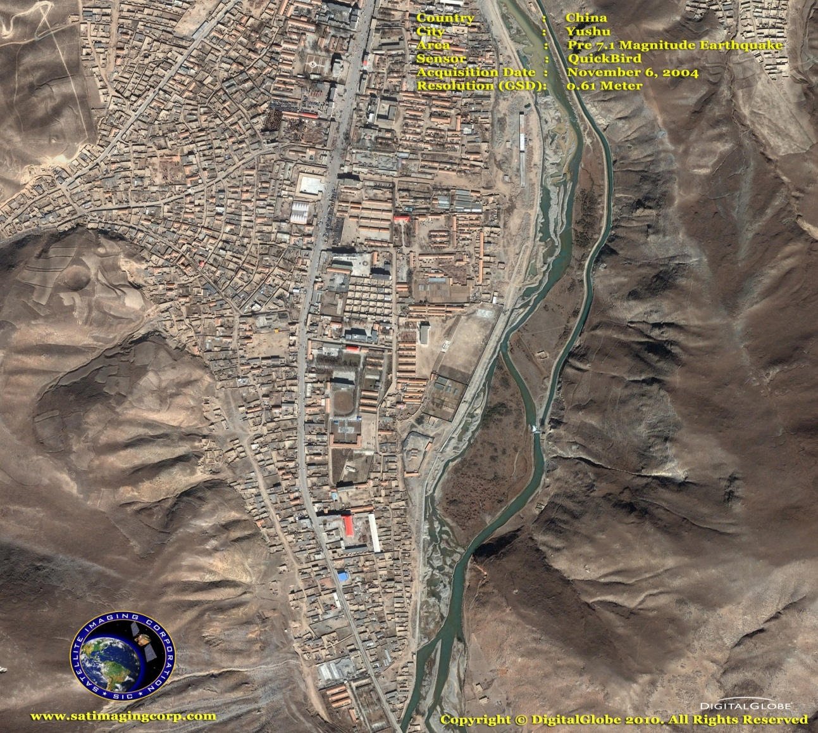
High Resolution Imagery – QuickBird
Notes:
This 0.6m satellite image, which was captured on November 6, 2004 by the QuickBird satellite sensor, depicts Yushu, China as it appeared prior to a devastating earthquake.

Slide 24
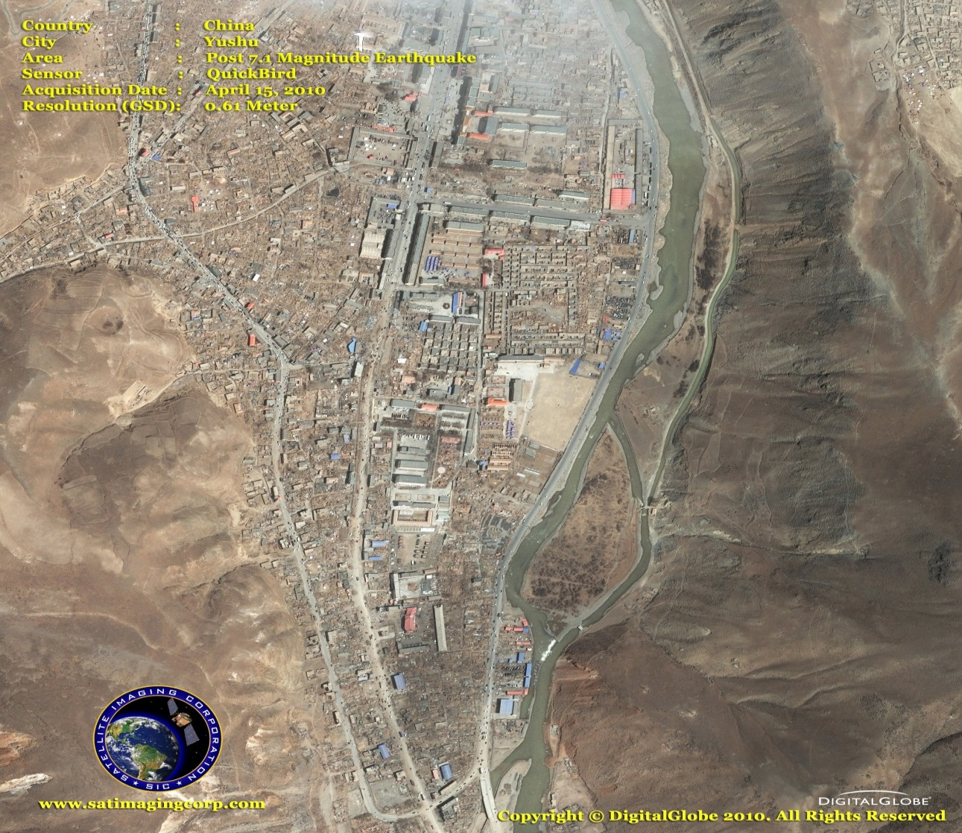
High Resolution Imagery – QuickBird
Notes:
This 0.6m satellite image, which was captured on April 15, 2010 by the QuickBird satellite sensor, depicts the city of Yushu, China as it appeared following a catastrophic earthquake.

Slide 25
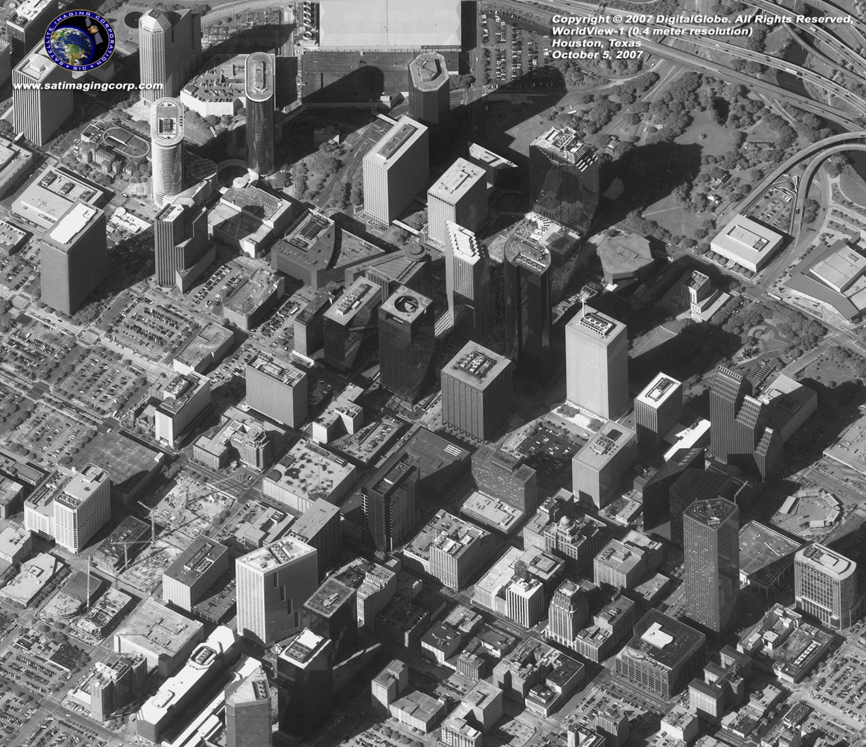
High Resolution Imagery – WorldView1
Notes:
WorldView-1's first images include half-meter snapshots from: Houston, Texas, USA acquired October 2, 2007

Slide 26
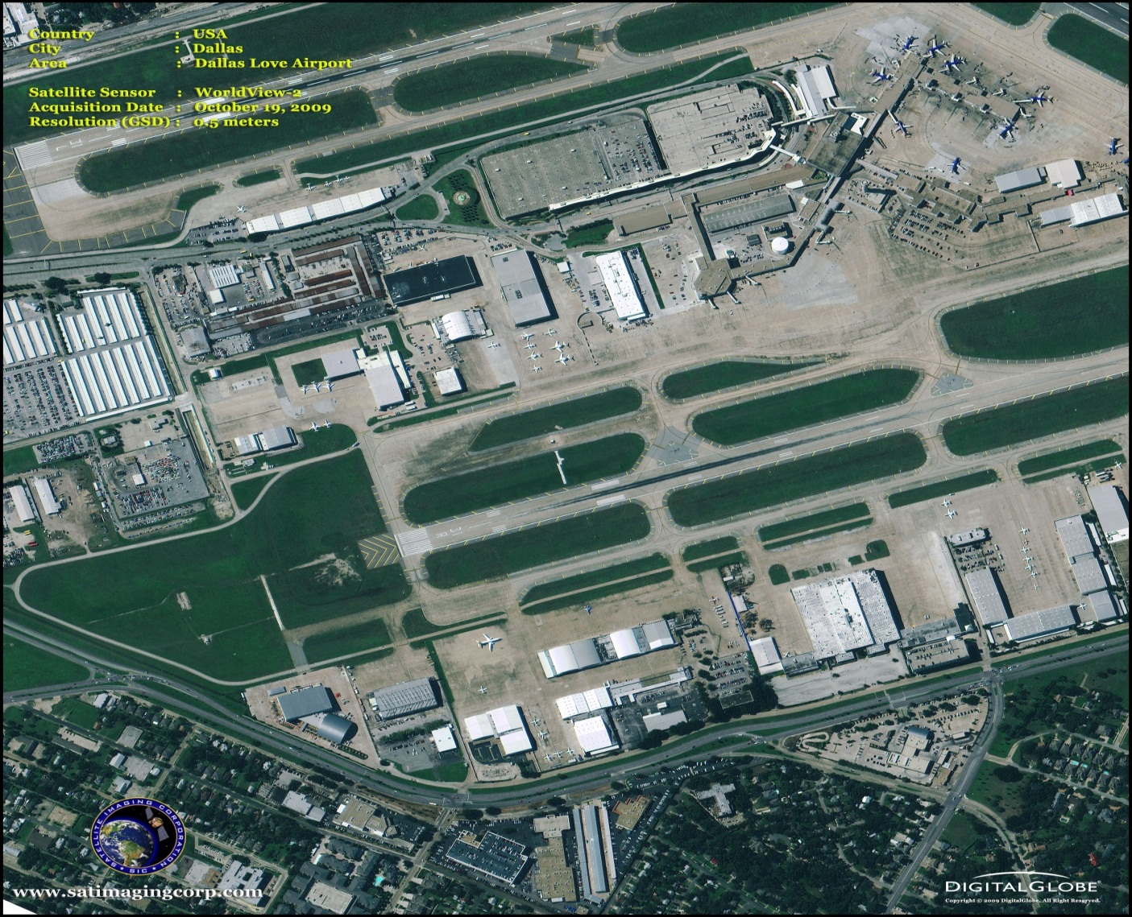
High Resolution Imagery – WorldView2
Notes:
This half-meter image of Dallas Love Field airport represents one of the first natural color snapshots ever collected by the WorldView-2 satellite.

Slide 27
Error Matrix
A tabular result of the comparison of the pixels in a classified image to known reference information
Rows and columns of the matrix contain pixel counts
Permits the calculation of the overall accuracy of the classification, as well as the accuracy of each class

Slide 28
Error Matrix Example
classified image
reference data
Notes:
Which cells represent the accurately classified pixels?

Slide 29
Evaluation of Error Matrices
Ground reference test information is compared pixel by pixel (or polygon by polygon when the remote sensor data are visually interpreted) with the information in the remote sensing–derived classification map.
Agreement and disagreement are summarized in the cells of the error matrix.
Information in the error matrix may be evaluated using simple descriptive statistics or multivariate analytical statistical techniques.

Slide 30
Types of Accuracy
Overall accuracy
Producer’s accuracy
User’s accuracy
Kappa coefficient

Slide 31
Descriptive Statistics
The overall accuracy of the classification map is determined by dividing the total correct pixels (sum of the major diagonal) by the total number of pixels in the error matrix (N ).
The total number of correct pixels in a category is divided by the total number of pixels of that category as derived from the reference data (i.e., the column total).
This statistic indicates the probability of a reference pixel being correctly classified and is a measure of omission error. This statistic is the producer’s accuracy because the producer (the analyst) of the classification is interested in how well a certain area can be classified.

Slide 32
Producer’s Accuracy
classified image
reference data
The probability a reference pixel is being properly classified
measures the “omission error” (reference pixels improperly classified are being omitted from the proper class)
150/180 = 83.33%
Notes:
The probability a reference pixel is being properly classified
measures the “omission error” (reference pixels improperly classified are being omitted from the proper class)
150/180 = 83.33%

Slide 33
Overall Accuracy
The total number of correctly classified samples divided by the total number of samples
measures the accuracy of the entire image without reference to the individual categories
sensitive to differences in sample size
biased towards classes with larger samples

Slide 34
Overall Accuracy
classified image
reference data
Based on how much of each image class was correctly classified
total number of correctly classified pixels divided by the total number of pixels in the matrix
(150+55+105+50)/500 = 360/500 = 72%
Notes:
Based on how much of each image class was correctly classified
total number of correctly classified pixels divided by the total number of pixels in the matrix
(150+55+105+50)/500 = 360/500 = 72%

Slide 35
Descriptive Statistics
If the total number of correct pixels in a category is divided by the total number of pixels that were actually classified in that category, the result is a measure of commission error.
This measure, called the user’s accuracy or reliability, is the probability that a pixel classified on the map actually represents that category on the ground.

Slide 36
User’s Accuracy
classified image
reference data
The probability a pixel on the map represents the correct land cover category
measures the “commission error” (image pixels improperly classified are being committed to another reference class)
150/200 = 75%
Notes:
The probability a pixel on the map represents the correct land cover category
measures the “commission error” (image pixels improperly classified are being committed to another reference class)
150/200 = 75%

Slide 37
Kappa Analysis
K_{hat} Coefficient of Agreement:
Kappa analysis yields a statistic, , which is an estimate of Kappa.
It is a measure of agreement or accuracy between the remote sensing–derived classification map and the reference data as indicated by a) the major diagonal, and b) the chance agreement, which is indicated by the row and column totals (referred to as marginals).

Slide 38
Kappa Coefficient
Expresses the proportionate reduction in error generated by the classification in comparison with a completely random process.
A value of 0.82 implies that 82% of the errors of a random classification are being avoided

Slide 39
Kappa Coefficient
The Kappa coefficient is not as sensitive to differences in sample sizes between classes and is therefore considered a more reliable measure of accuracy; Kappa should always be reported
Notes:
It’s the “standard” measure of classification accuracy

Slide 40
Kappa Coefficient
A Kappa of 0.8 or above is considered a good classification; 0.4 or below is considered poor

Slide 41
Kappa Coefficient
Where:
r = number of rows in error matrix
n_{ij} = number of observations in row i, column j
n_{i} = total number of observations in row i
n_{j} = total number of observations in column j
M = total number of observations in matrix

Slide 42
Kappa Coefficient
classified image
reference data
Notes:
Work through equation

Slide 43
Error matrix of the classification map derived from hyperspectral data of the Mixed Waste Management Facility on the Savannah
River Site.
121/121=

